Slide 1
RUP vs. Spiralmodell

Slide 2
RUP
 | Inception |  | Elaboration |  |  | Construction |  |  | Transition
 | L1 |  | E1 | E2 | C1 | C2 | C3 | C4 | T1 | T2
Business Modeling
Requirements
Analysis & Design
Implementation
Test
Deployment
 | Time

Slide 3
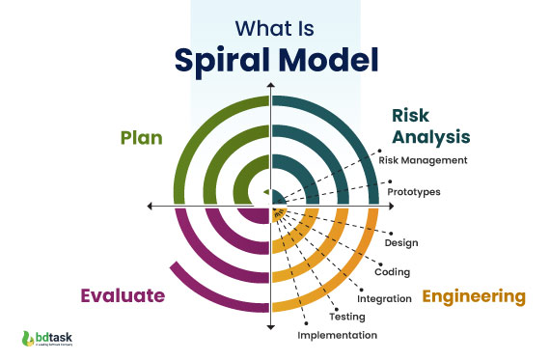
Spiralmodell

